Slide 1
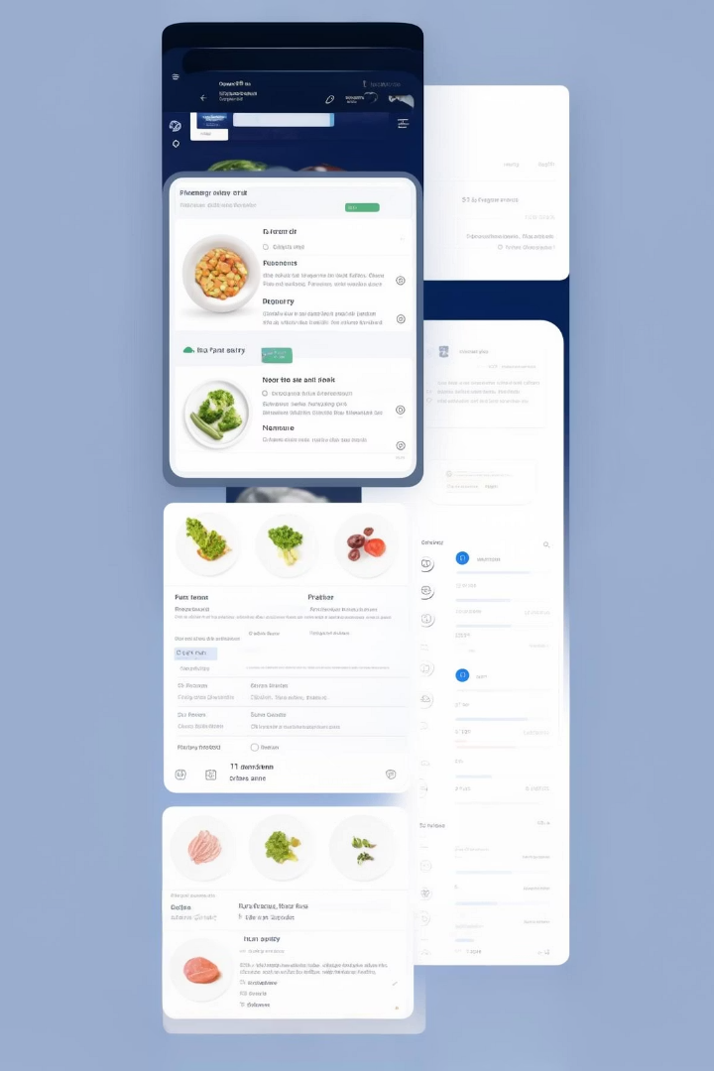
PantryPal
Welcome to the PantryPal. This comprehensive guide outlines the architecture, components, and functionality of our Android application designed to simplify meal planning and grocery management.
PantryPal adopts the MVVM architecture, integrating Jetpack Compose, Room database, and Retrofit to create a modular, maintainable Android application that helps users manage their pantry, discover recipes, and organize grocery shopping.

Slide 2
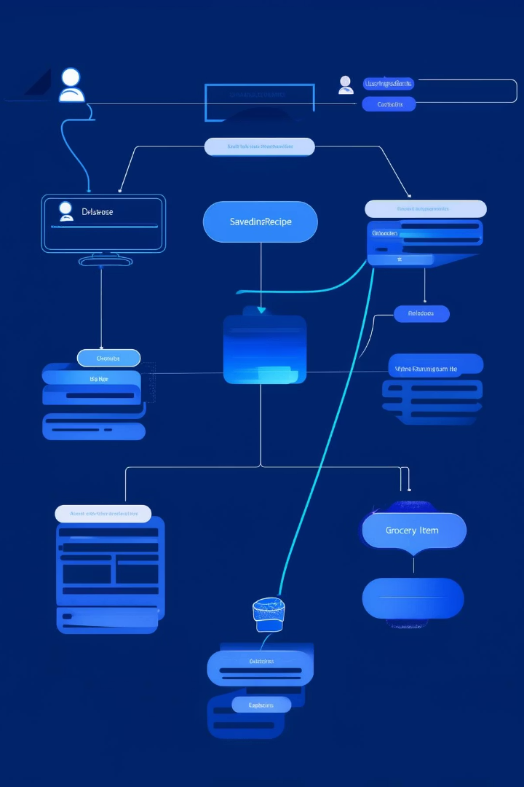
Database Design
Entity
Primary Purpose
Key Fields
User
Authentication
id, username, password, email
SavedRecipe
Recipe storage
id, label, image, url, userId, cookbookName
UserIngredients
Pantry management
id, name, type, expiryDate, userId
GroceryItem
Shopping lists
id, name, quantity, unit, isChecked, userId
PantryPal's database design centers around four main entities registered in AppDatabase.kt. The User entity handles authentication, while SavedRecipe stores recipes with a cookbookName field for logical grouping without requiring a separate table.
UserIngredients represents the user's pantry contents with expiry tracking, and GroceryItem manages shopping lists with check-off functionality. All entities maintain user association through userId fields for proper data isolation.

Slide 3








UI Screens & Navigation
Recipe Search
Cookbook
Find recipes by ingredients
Manage saved recipes
Profile
Grocery List
User settings
Track shopping items
PantryPal's UI is built entirely with Jetpack Compose, organized into screen directories for each major feature. Navigation is handled through a bottom navigation bar defined in BottomNavigation.kt, providing easy access to the app's primary functions.
The main screens include RecipeSearchScreen for discovering recipes, CookBookScreen for managing saved recipes, GroceryListScreen for shopping lists, and profile-related screens for user management. Each screen connects to its respective ViewModel to retrieve and update data.

Slide 4
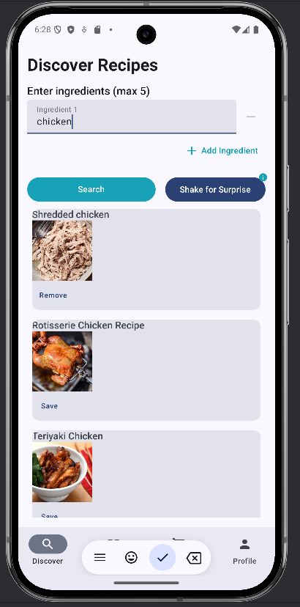
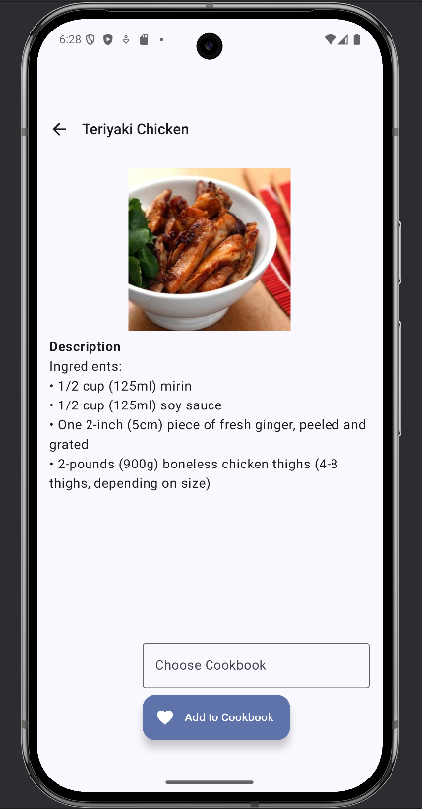
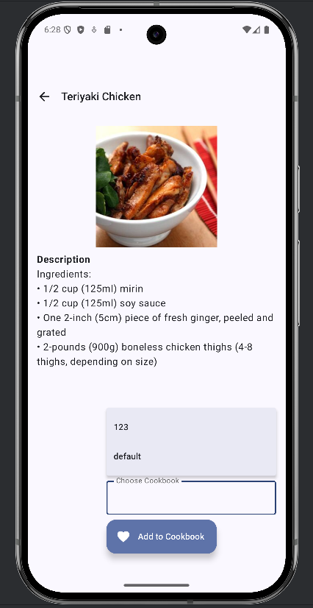

Slide 5
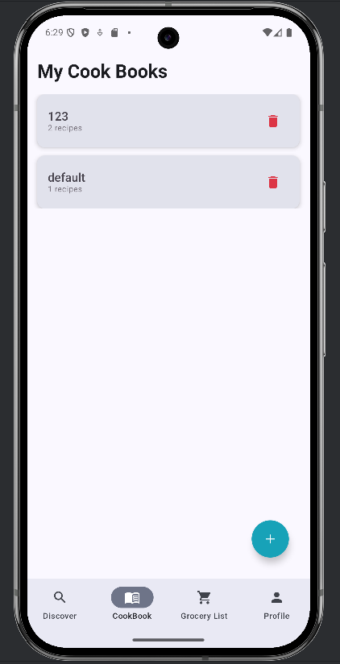
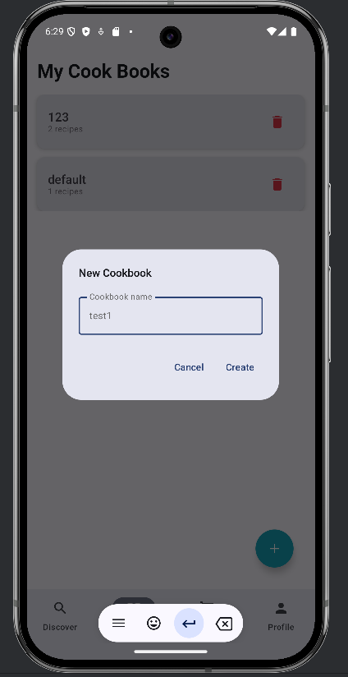
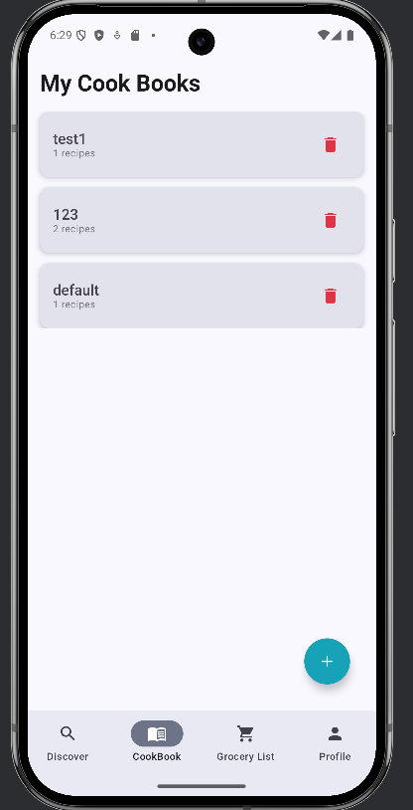

Slide 6
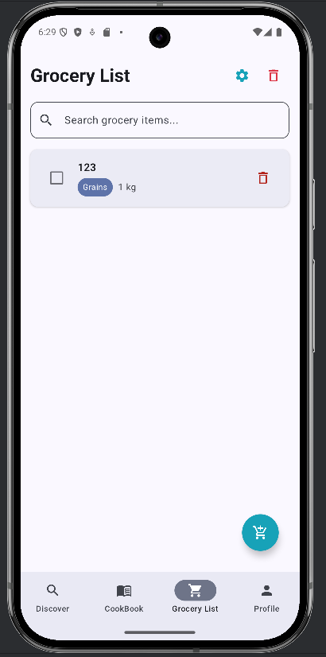
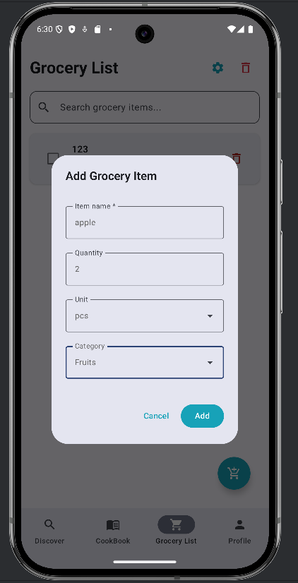
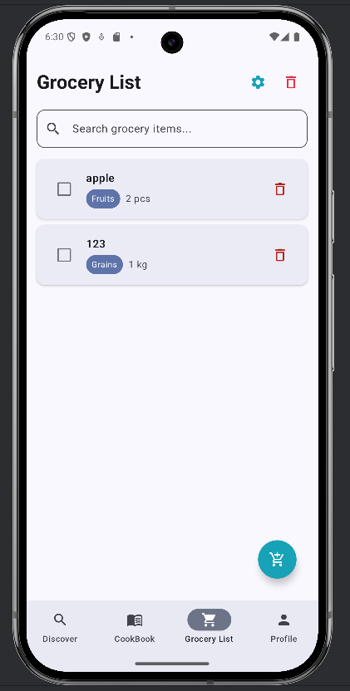

Slide 7
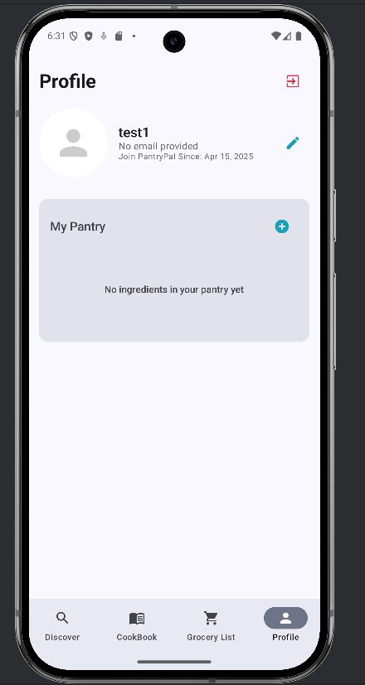
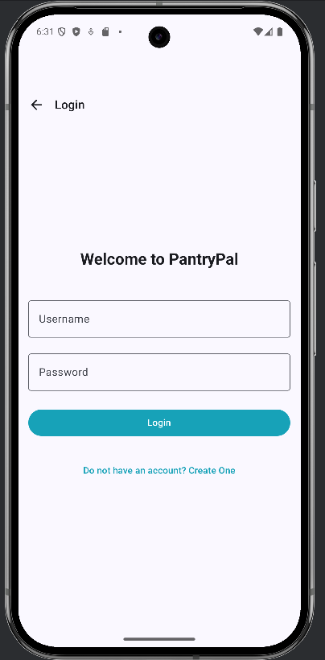
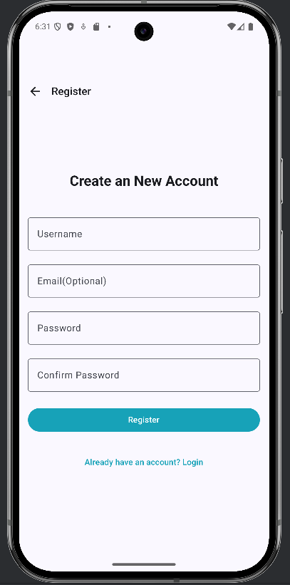

Slide 8
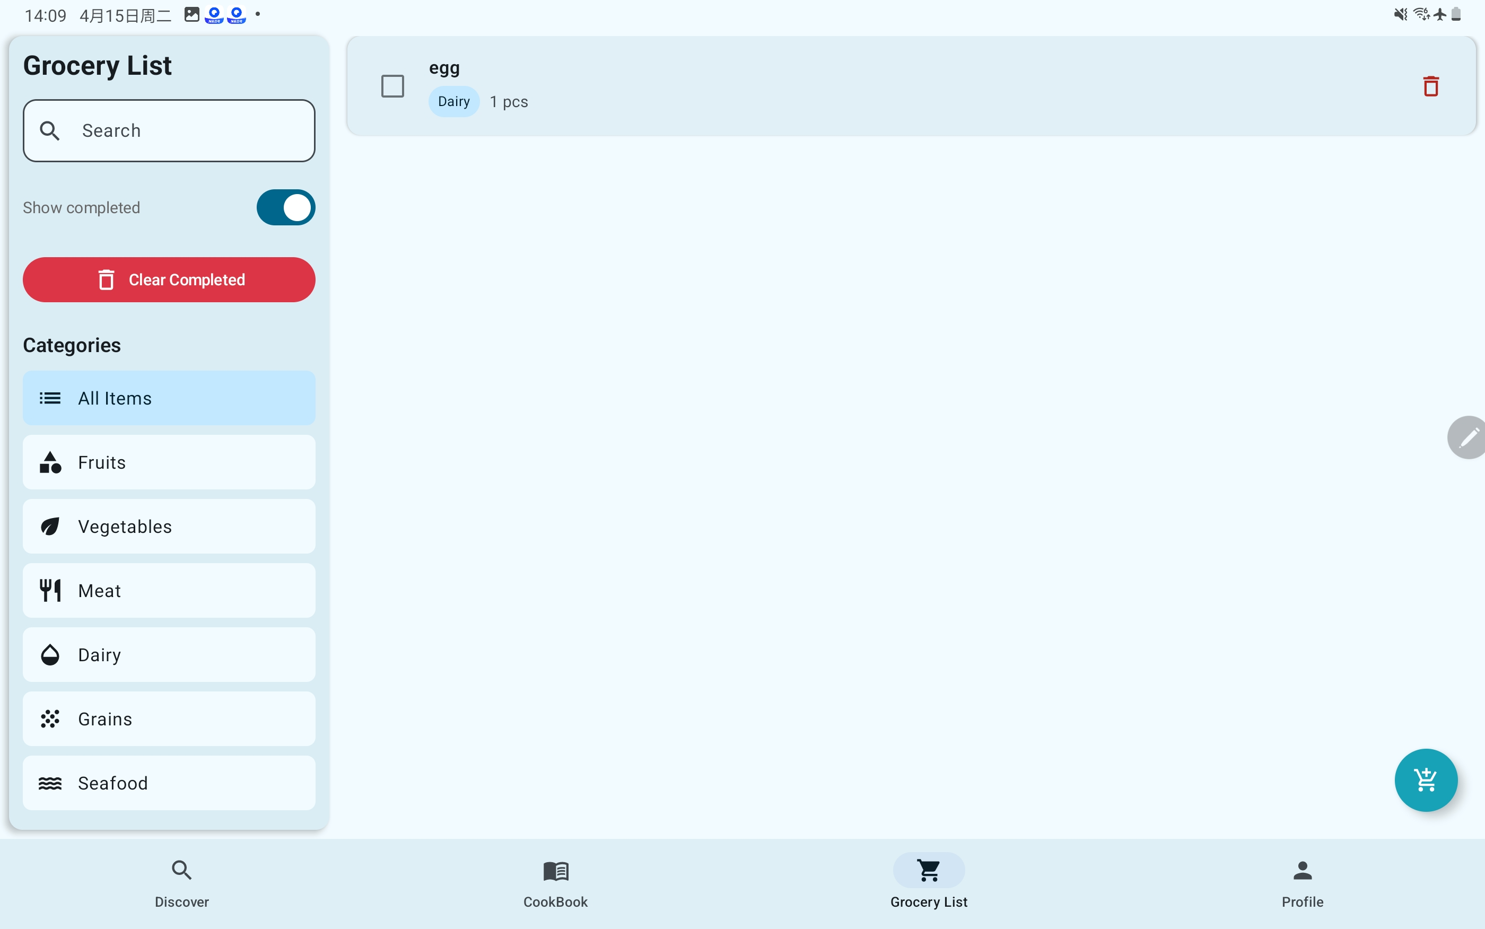

Slide 9
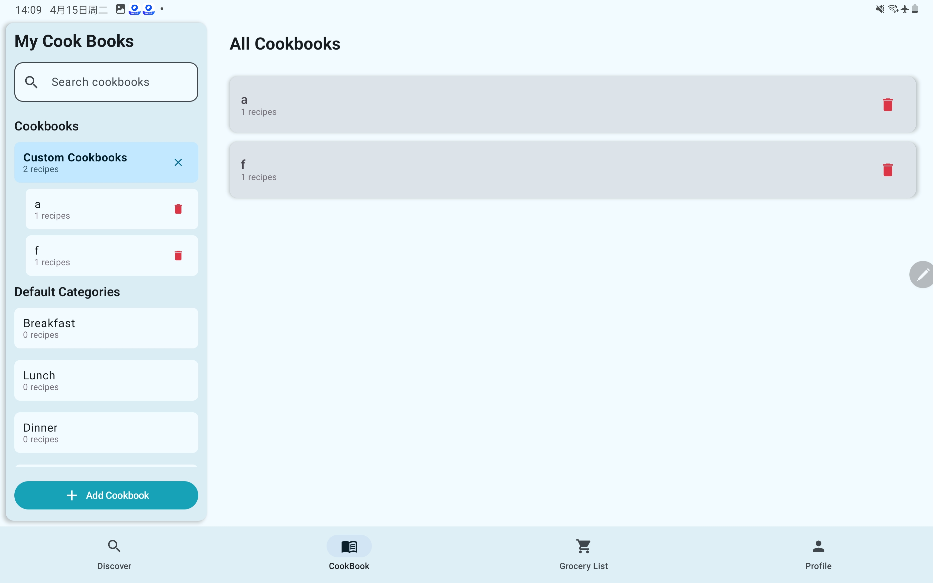

Slide 10
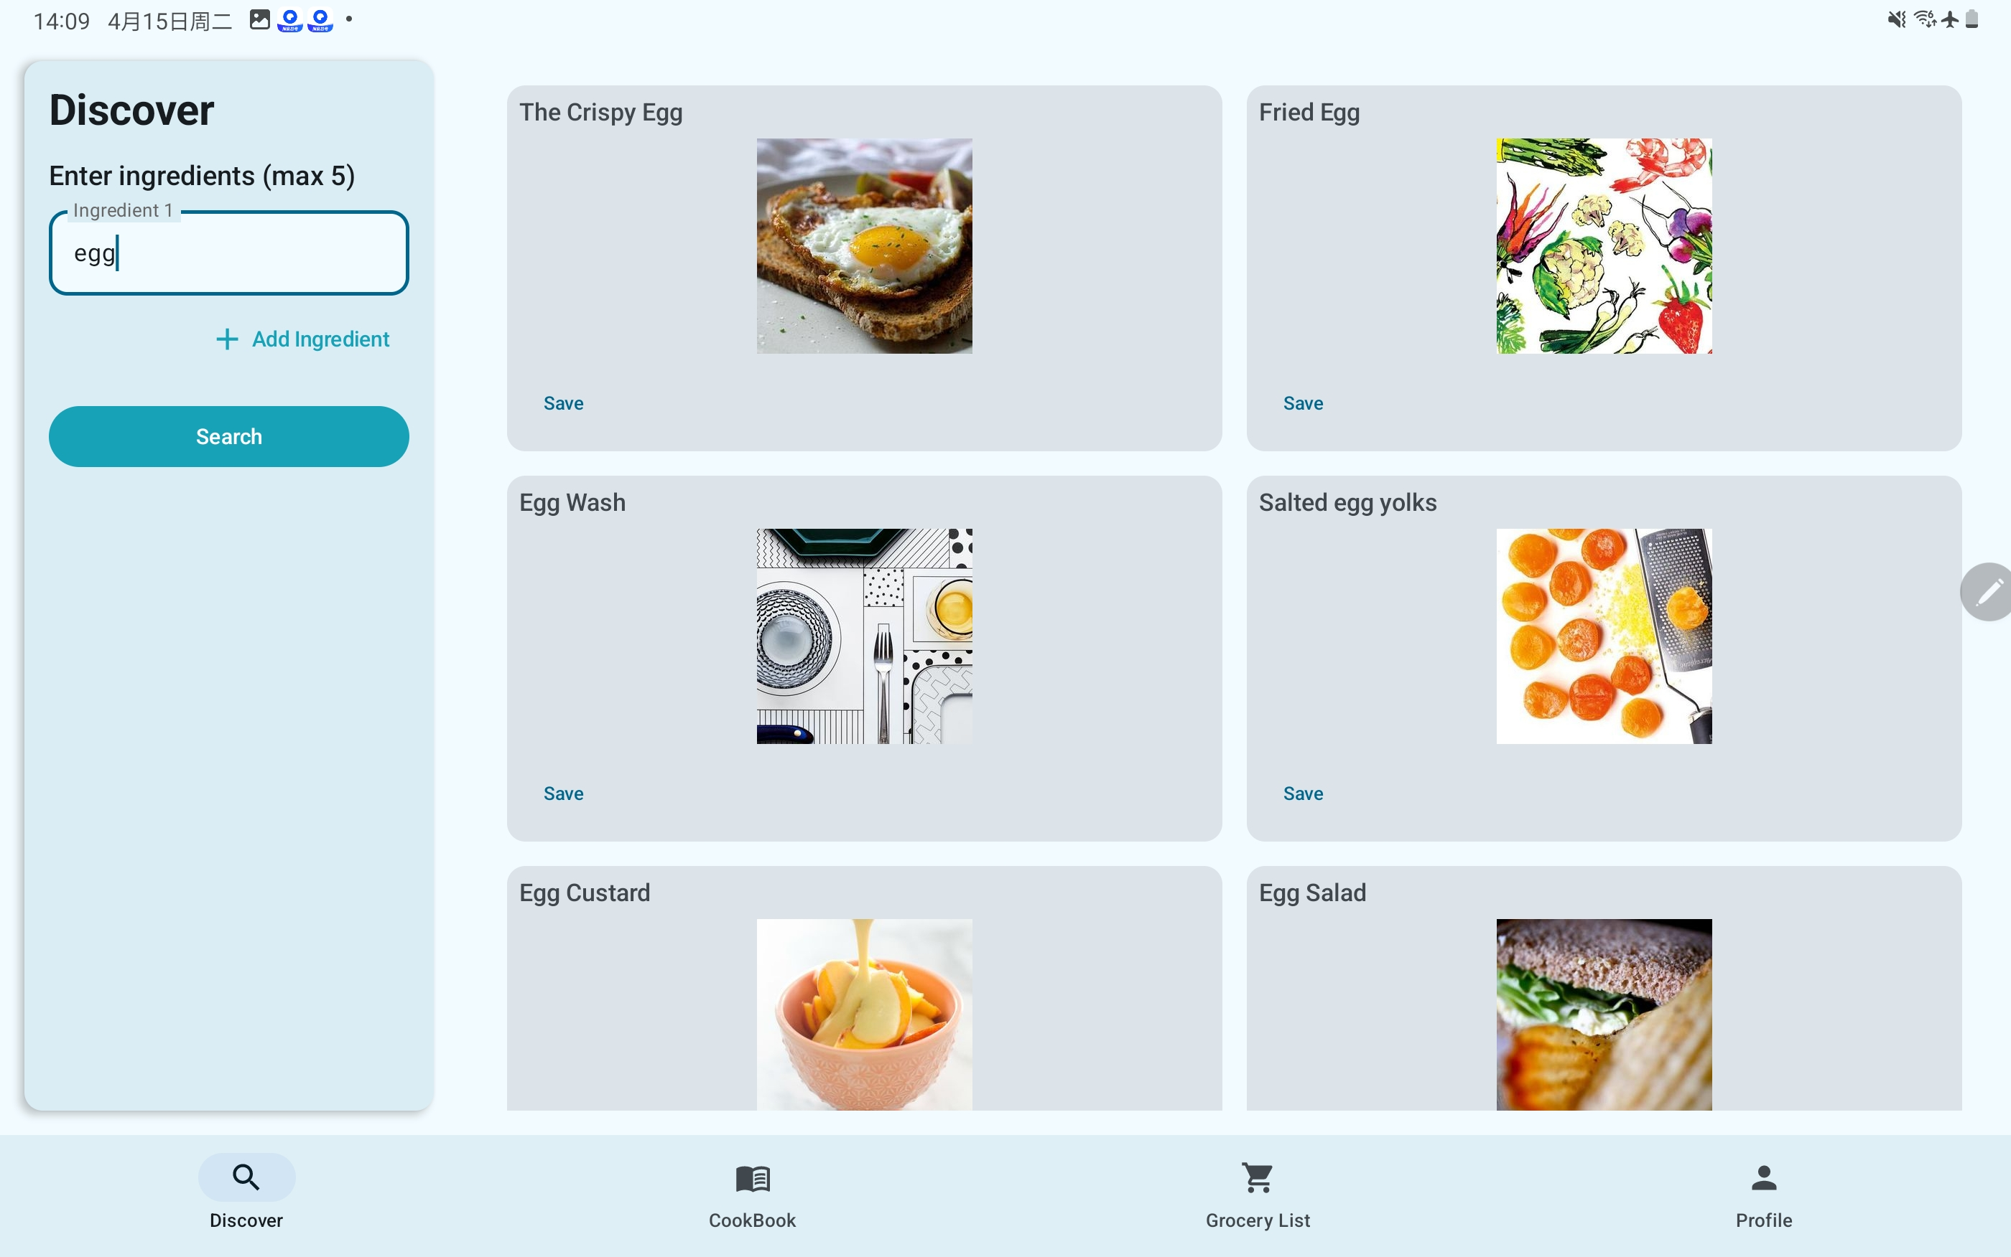

Slide 11
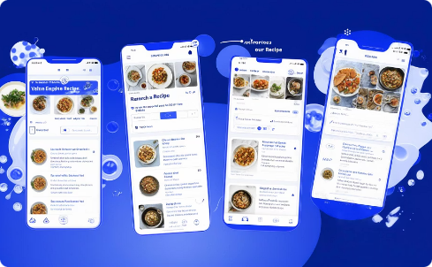
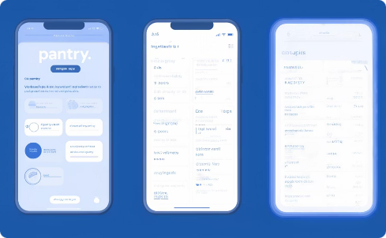
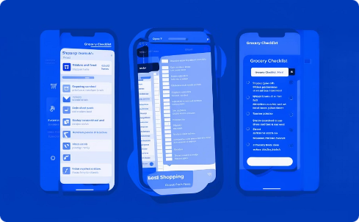
Feature Overview & Next Steps
Recipe Search & Save
Pantry Management
Grocery List
Search recipes via Edamam API by keywords, save to selected cookbooks, and toggle favorites for quick access.
Track fridge contents with categories and expiry dates, with potential for expiration notifications.
Create shopping lists with quantities and units, check off items while shopping, and manage categories.
PantryPal combines these core features into a comprehensive food management solution. The application architecture supports future enhancements such as barcode scanning for pantry additions, meal planning calendars, and nutritional analysis.
Known issues are being tracked and addressed in ongoing development. The modular architecture ensures new features can be added with minimal changes to existing components.

